Slide 1
Cycle Counts
WMS Guide

Slide 2
Table of Contents
Planned Cycle Count Creation….................................................................................3
Cycle Count with a Mobile Device…..........................................................................17
  System-Directed..…..............................................................................................17
  Cycle Count by Order..…......................................................................................24
  Demand Cycle Count..…......................................................................................28
Cycle Count with a Desktop Computer...…................................................................35
Cycle Count Exceptions.…..........................................................................................44

Slide 3
Planned Cycle Count Creation

Slide 4
Planned Cycle Count
Planned cycle counts have to be manually created by a user : they need to be planned in advance and then released to be performed.
This procedure is performed exclusively on a desktop computer.
The user will then perform and complete the cycle count using a desktop or a mobile computer.
This type of cycle count is mostly done for the year-end cycle count.

Slide 5
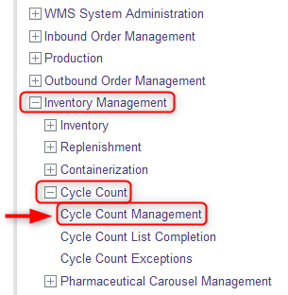
Planned Cycle Count
With a desktop computer, select the Inventory Management resource.
Under Inventory Management, click on Cycle Count.
Under Cycle Count, click on Cycle Count Management.

Slide 6
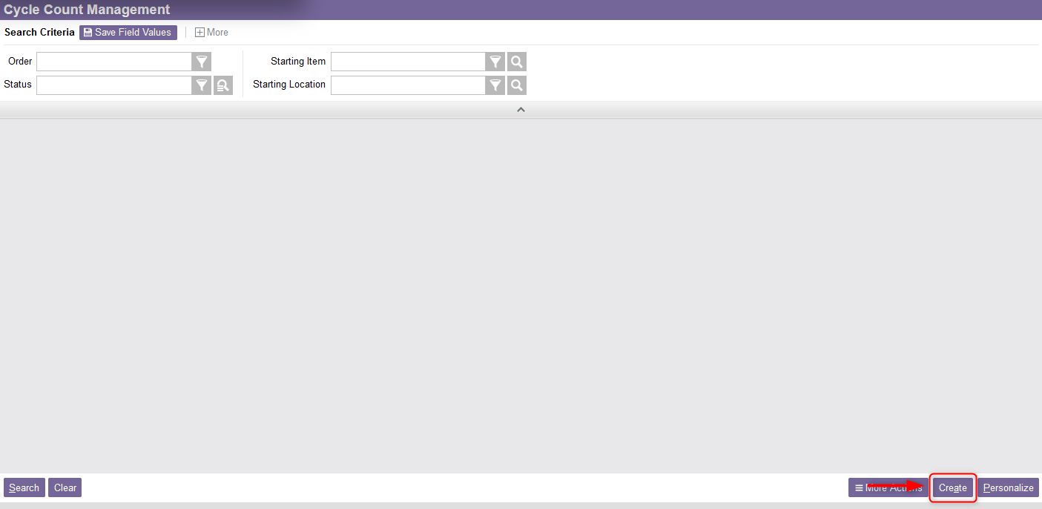
Planned Cycle Count
From the new window, select the Create action in the lower-right corner of your screen.

Slide 7
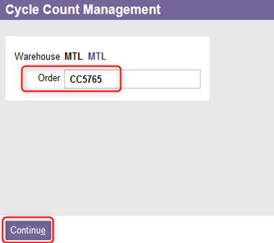
Planned Cycle Count
The next available cycle count order number is displayed. Change this value to a unique cycle count order number, if desired.
Click Continue.

Slide 8
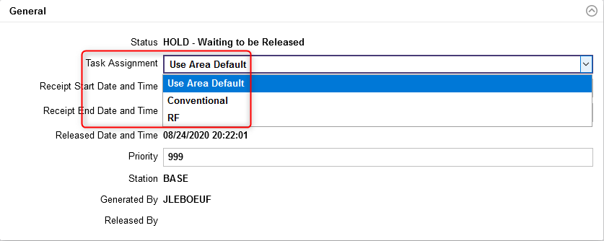
Planned Cycle Count
From the new window, in the General section, choose the Task Assignment:
    If “Conventional” is selected, the cycle count will be performed with a paper-based list;
    If “RF” is selected, the cycle count will be performed using a mobile device.

Slide 9
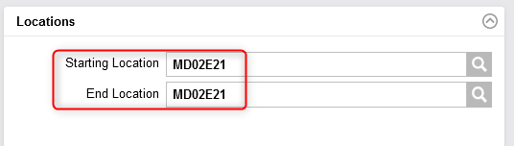
Planned Cycle Count
Specify the cycle count you want to plan by using one of the following options:
Option A: Specify a Starting Location and an End Location. The system will create cycle counts for all locations specified in the range from the beginning to the end location. If the Starting and End Location are identical, the system will only generate cycle counts for this specific location.

Slide 10
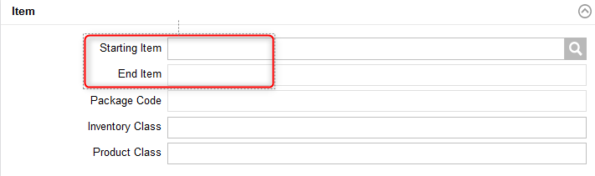
Planned Cycle Count
Option B: Specify a Starting Item and an End Item. This will schedule cycle counts for all locations in which the specified items, and any items defined in between, are stored. If the Starting and End Items are identical, the system will only specify cycle counts for locations containing this item.

Slide 11
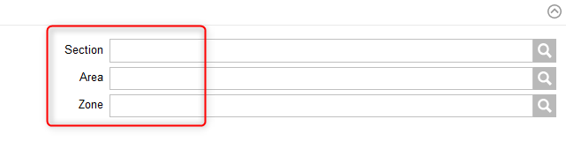
Planned Cycle Count
Option C: Specify a Section or a Zone or an Area. The system will create cycle counts for the section/zone/area specified in this field.

Slide 12
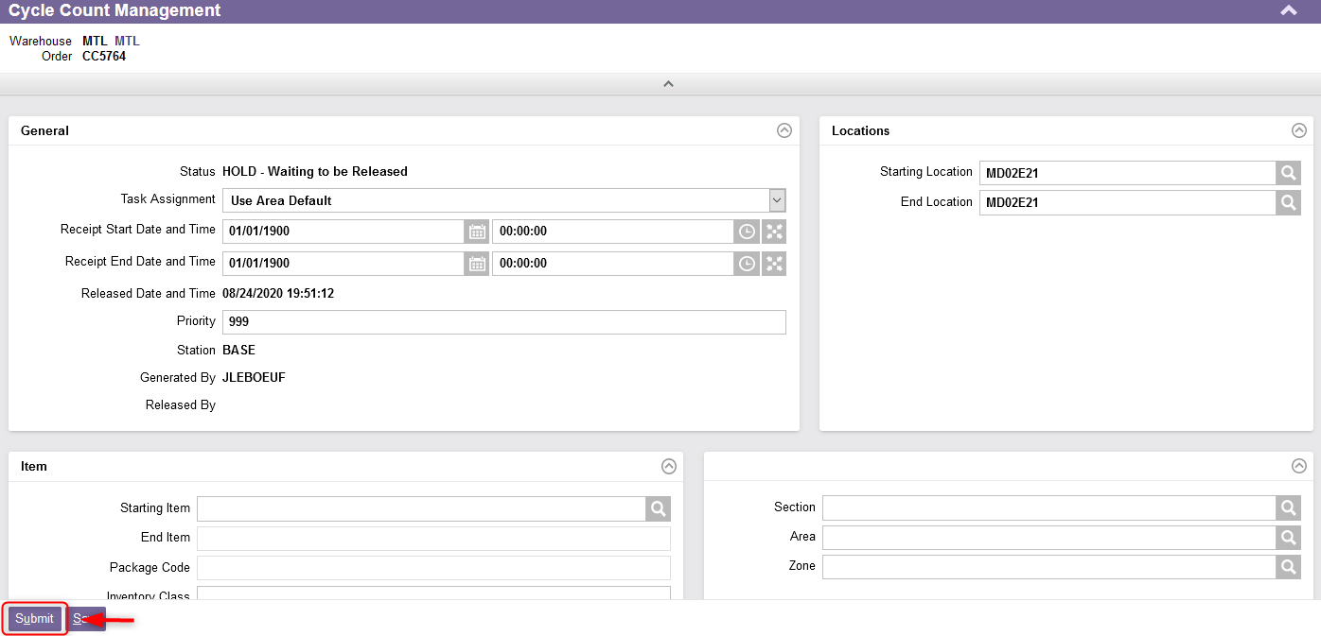
Planned Cycle Count
Once the fields have been entered, select the Submit action. The cycle count order is created.

Slide 13
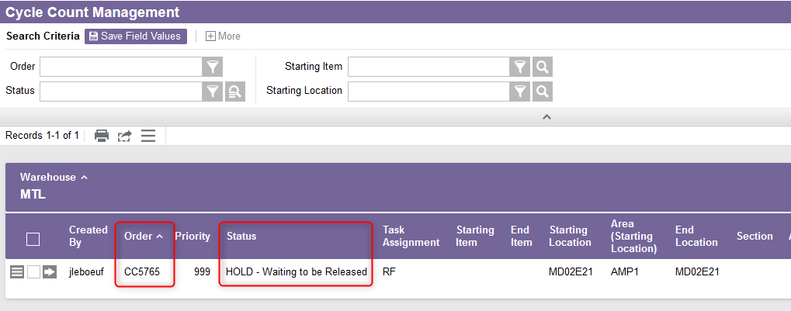
Planned Cycle Count
Additional Note: The cycle count created will have the status "HOLD - Waiting to be Released". As long as it has not been released, you can view it by selecting the "Cycle Count Management" resource again.

Slide 14
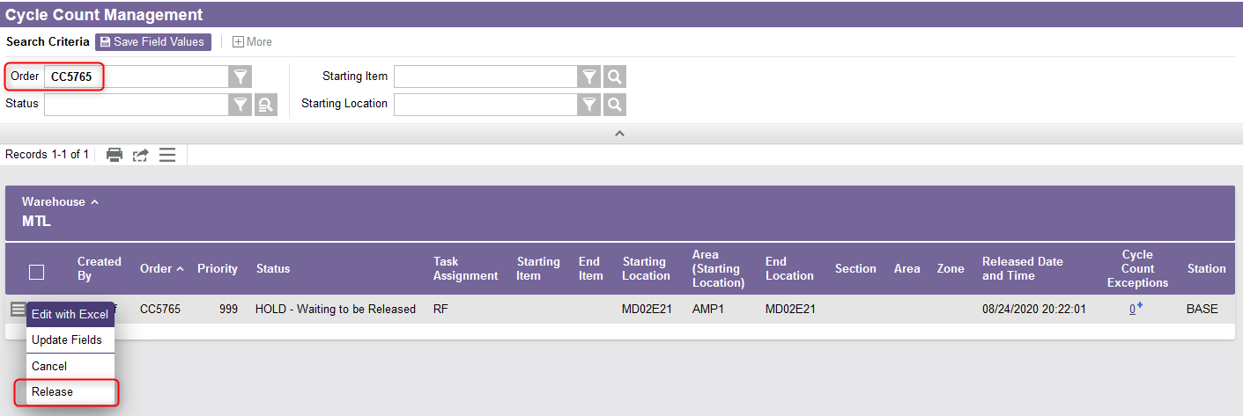
Planned Cycle Count
Access the “Cycle Count Management” resource again.
Retrieve the Cycle Count Order in the list using the search criteria if necessary.
Select the Use Record as Criteria for Action button and click on the Release action.

Slide 15
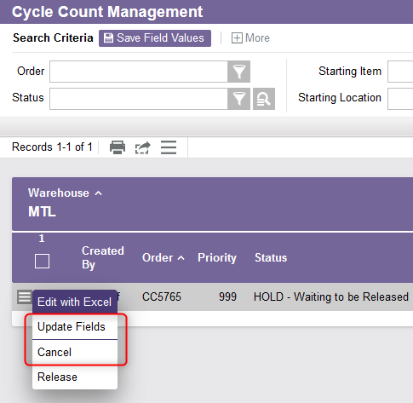
Planned Cycle Count
Additional Note:
  Before releasing the cycle count, you still have the option to cancel or edit it if necessary.
  Once released, you only have the option to cancel it (and not to edit it).

Slide 16
Planned Cycle Count
The cycle count is now available to be performed through a paper-based list or a mobile device:
  To perform the cycle count with a mobile device, refer to the Cycle Count with a Mobile Device section (either System-Directed or Cycle Count by Order);
  To perform the cycle count with a paper-based list, refer to the Cycle Count with a Desktop Computer section.

Slide 17
Cycle Count with a Mobile Device
System-directed

Slide 18
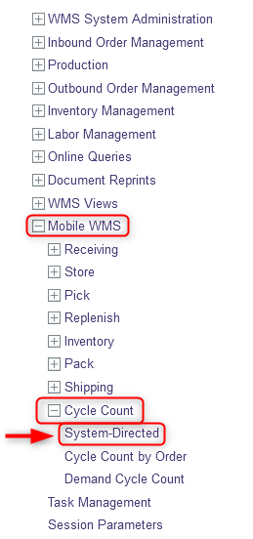
System-directed Cycle Count
The user may choose to perform system-directed cycle counts, where the system specifies what location is to be cycle counted. The system-directed resource will display the cycle counts in order of priority based on the command sequences. To do this:
With a mobile device, select the Cycle Count resource.
Under Cycle Count, click on System Directed.

Slide 19
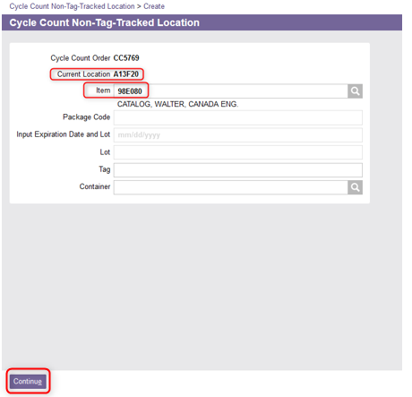
System-directed Cycle Count
Go to the location specified in the Current Location field.
Enter the item in the location to be counted.
Click Continue.

Slide 20
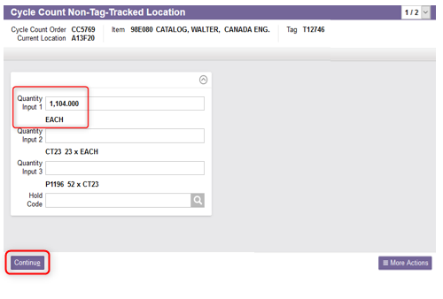
System-directed Cycle Count
From the new window, enter the counted quantity of the item in the Quantity Input field using the appropriate Unit of Measure.
Click Continue.

Slide 21
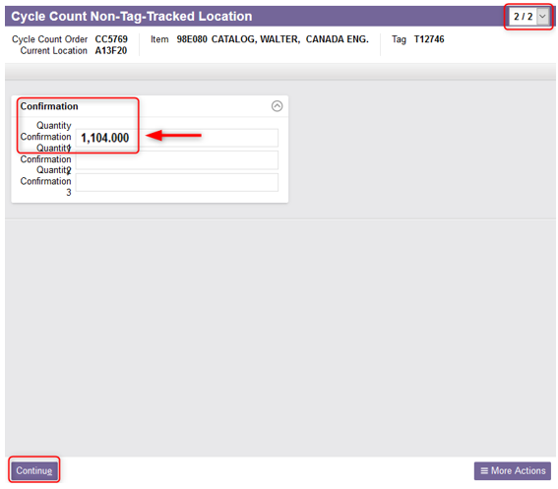

System-directed Cycle Count
A second page will be displayed:
  If what the user is counting is different from what the system expects, the system will require a confirmation of the quantity. In such a case, confirm again the quantity counted and click Continue.
  If there is no discrepancy, just click Continue.

Slide 22
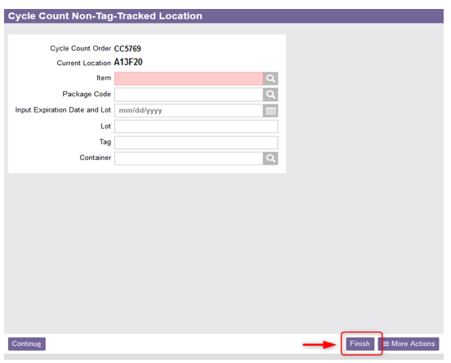
System-directed Cycle Count
The system will redirect you to the first Cycle Count window. Repeat steps 4 to 8 until all inventory of the location is counted.
When all entries have been entered, simply select the Finish action in the lower right corner.

Slide 23
System-directed Cycle Count
You will then be redirected to the main cycle count window to display the next location to count (based on the command priority).
Repeat steps 3 to 10 until all cycle count commands are completed.
When the last command is completed, the system will prompt a message indicating that the last task has been reached:
You can click Close to close the screen.

Slide 24
Cycle Count with a Mobile Device
Cycle Count by Order

Slide 25
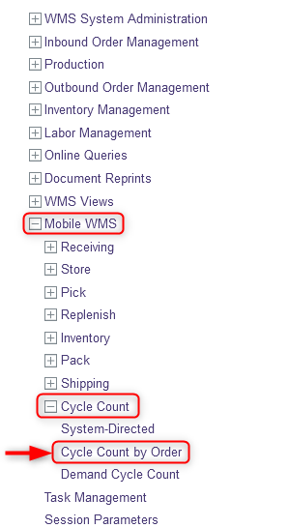
Cycle Count by Order
This resource is used to perform a specific planned cycle count which has been previously planned and released with a desktop computer (refer to Planned Cycle Count Creation section). To do this:
With a mobile device, select the Cycle Count resource.
Under Cycle Count, click on Cycle Count by Order.

Slide 26
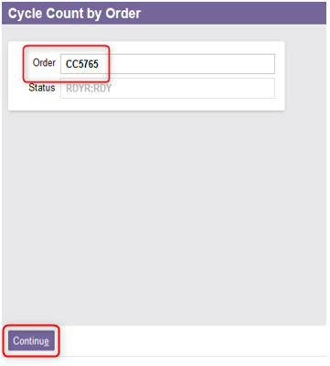
Cycle Count by Order
From the new window, enter the Order ID of the cycle count (previously planned and released)
Click Continue.

Slide 27
Cycle Count by Order
A new window to perform the cycle count will appear. At this point, the steps are similar to the system-directed cycle count explained previously. Refer to the steps of the System-Directed Cycle Count section for the rest of this procedure.
Once the planned cycle count has been completed, the system will display a confirmation message:

Slide 28
Cycle Count with a Mobile Device
Demand Cycle Count

Slide 29
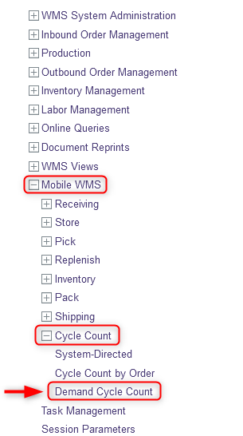
Demand Cycle Count
A user may demand a cycle count for some locations. The Demand Cycle Count resource allows a user to count a location on demand (i.e., without a planned or system-directed cycle count command). To do this:
With a mobile device, select the Cycle Count resource.
Under Cycle Count, click on Demand Cycle Count

Slide 30
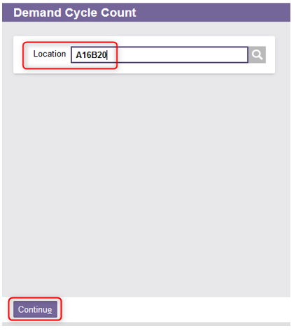
Demand Cycle Count
From the new window, enter the desired Location for which you wish to count.
Click Continue.

Slide 31
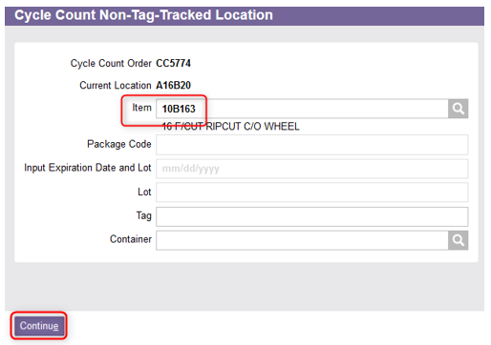
Demand Cycle Count
A new window to perform the cycle count will appear.
At this point, the steps are similar to the system-directed cycle count explained previously. Refer to the steps of the System-Directed Cycle Count section for the rest of this procedure.

Slide 32
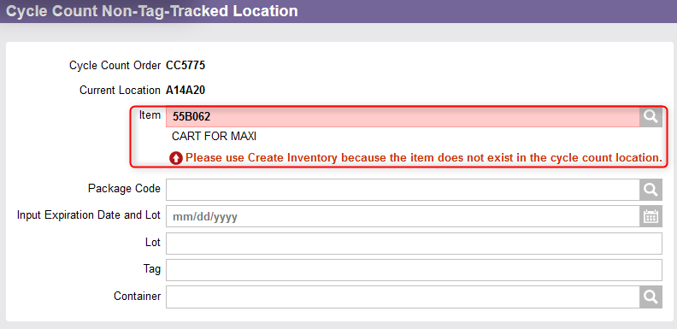
Demand Cycle Count
Additional Note – Inventory for a product may be created through a cycle count. If a product, for which no inventory record exists in the system, is found during a cycle count, the system will ask you to have the inventory created.

Slide 33
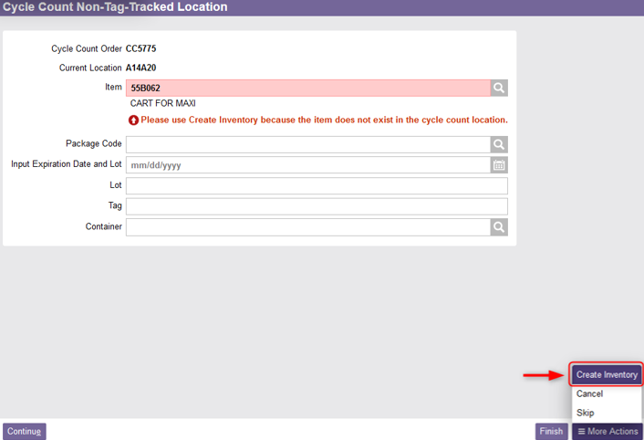
Demand Cycle Count
Additional Note (continued) – To create inventory for a product:
Click on More Actions in the lower right corner of the screen.
Then select the Create Inventory action.

Slide 34
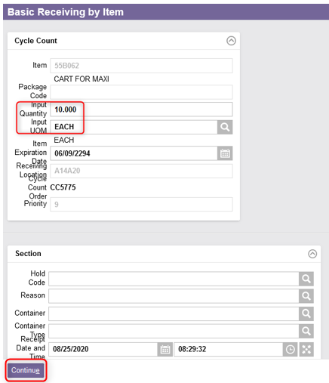
Demand Cycle Count
Additional Note (continued)
From the new Basic Receiving by Item window, enter the quantity of the product and the unit of measure.
Click Continue.
You will be redirected to the Cycle Count resource, click Finish.

Slide 35
Cycle Count with a Desktop Computer

Slide 36
Cycle Count with a Desktop Computer
When a cycle count is generated through a desktop computer, a paper-based list will be printed to be used by the user to perform the requested cycle count.
The Cycle Count List header contains the Cycle Count Order, which appears in the upper left-hand corner of the list.
For each line item on the cycle count list, the following information is provided:
    Location to be cycle counted
    Tag assumed to be in the location
    Item and Description
    Quantity field and Unit of Measure

Slide 37
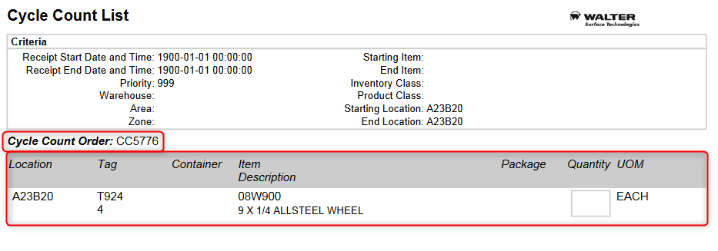
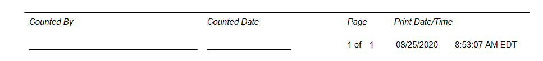
Cycle Count with a Desktop Computer

Slide 38
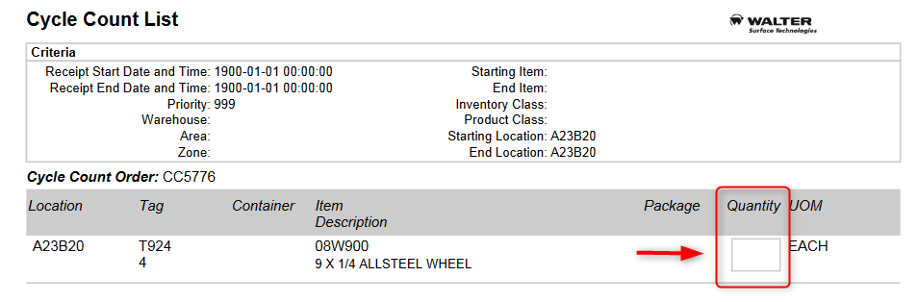
Cycle Count with a Desktop Computer
To perform a cycle count from a paper-based list:
Take the Cycle count list.
Count the locations specified on the list and enter the actual quantities in the Quantity column.

Slide 39
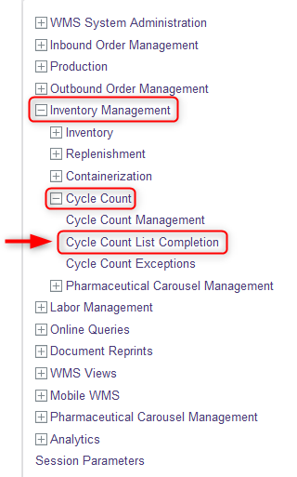
Cycle Count with a Desktop Computer
When all of the locations on the cycle count list have been counted, the user needs to complete the list using a desktop computer:
Select the Inventory Management resource.
Under Inventory Management, click on Cycle Count.
Under Cycle Count, click on Cycle Count List Completion.

Slide 40
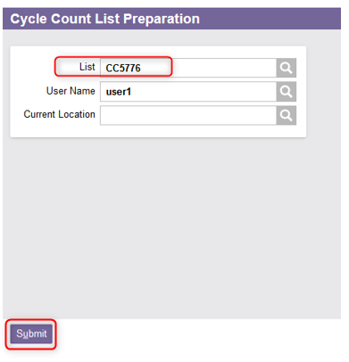
Cycle Count with a Desktop Computer
From the Cycle Count List Preparation window, select the cycle count list number.
Click Submit.

Slide 41
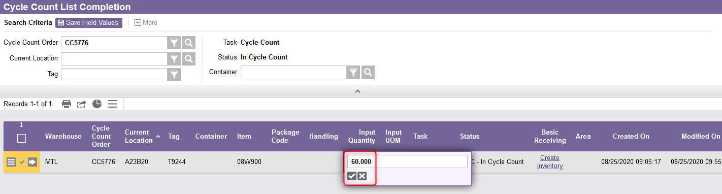
Cycle Count with a Desktop Computer
The system will display the Cycle Count List Completion window with the list of all records that are linked to the specified cycle count list.
For each line, enter the actual quantity counted in the Input Quantity field.

Slide 42

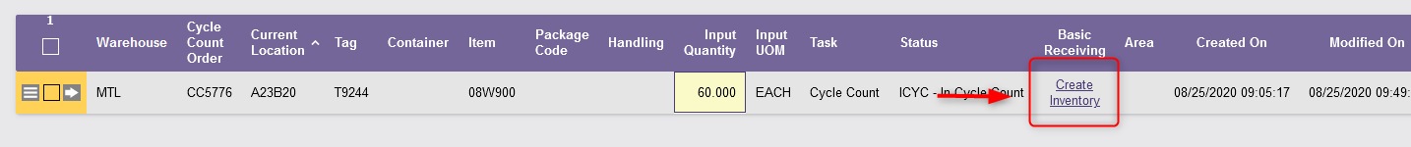
Cycle Count with a Desktop Computer
If what the user counted is different from what the system expects:
  The system will require a confirmation of the quantity. Click "Yes" to confirm.
  If the quantity is more than the system expected, you have the option of creating inventory. Select the Create Inventory action. Follow the same steps as explained in slides 32 to 34.

Slide 43
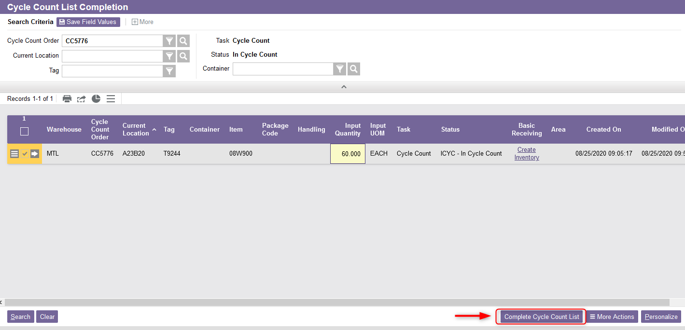
Cycle Count with a Desktop Computer
Once all counts have been entered, select the Complete Cycle Count List action:
This ends the process of cycle count with a desktop computer.

Slide 44
Cycle Count Exceptions

Slide 45
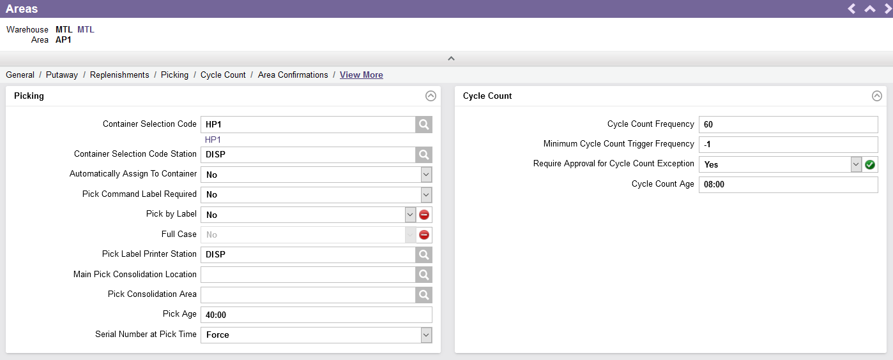
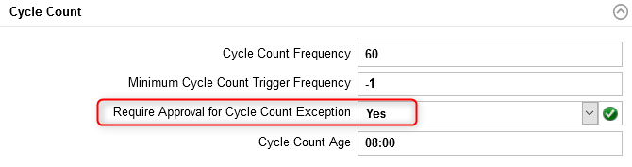
Cycle Count Exceptions
Depending on the warehouse area, if the "Require Approval for Cycle Count Exception" field is set to Yes in the Areas settings, the cycle count must be approved before the inventory is adjusted in the system.
As soon as an adjustment has been made which requires approval, the responsible person will be notified by email.
This procedure only works following a cycle count with a mobile device (and not following the completion of a cycle count list on a desktop computer).

Slide 46
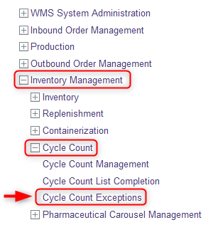
Cycle Count Exceptions
To approve a cycle count, do this:
On a desktop computer, select the Inventory Management resource.
Under the Inventory Management resource, click on Cycle Count.
Under Cycle Count, select Cycle Count Exceptions.
Notes:
T

Slide 47
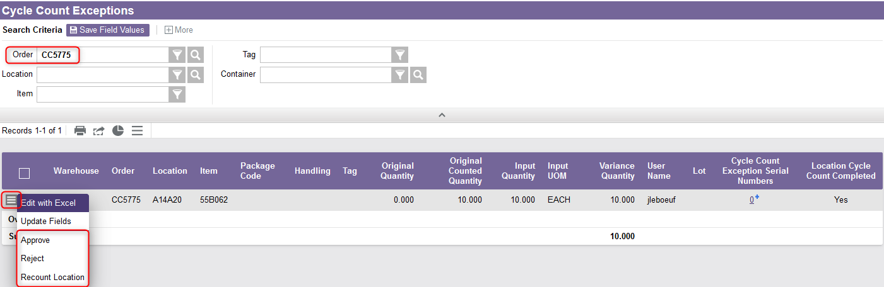
Cycle Count Exceptions
From the new window, the list of all cycle counts will appear. Perform a search to retrieve a specific cycle count if needed.
Then click on the Use Record as Criteria for Action button and choose one of the following options: Approve, Reject, or Recount Location.

